Slide 1
Budget Application
Welcome !

Slide 2
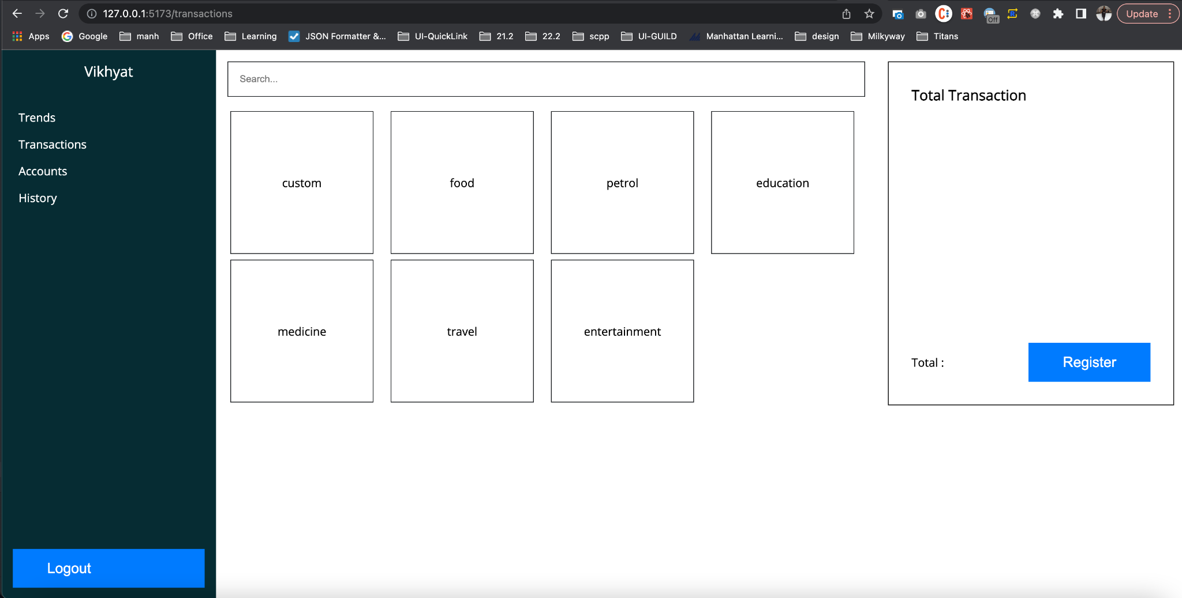
Transaction screen

Slide 3
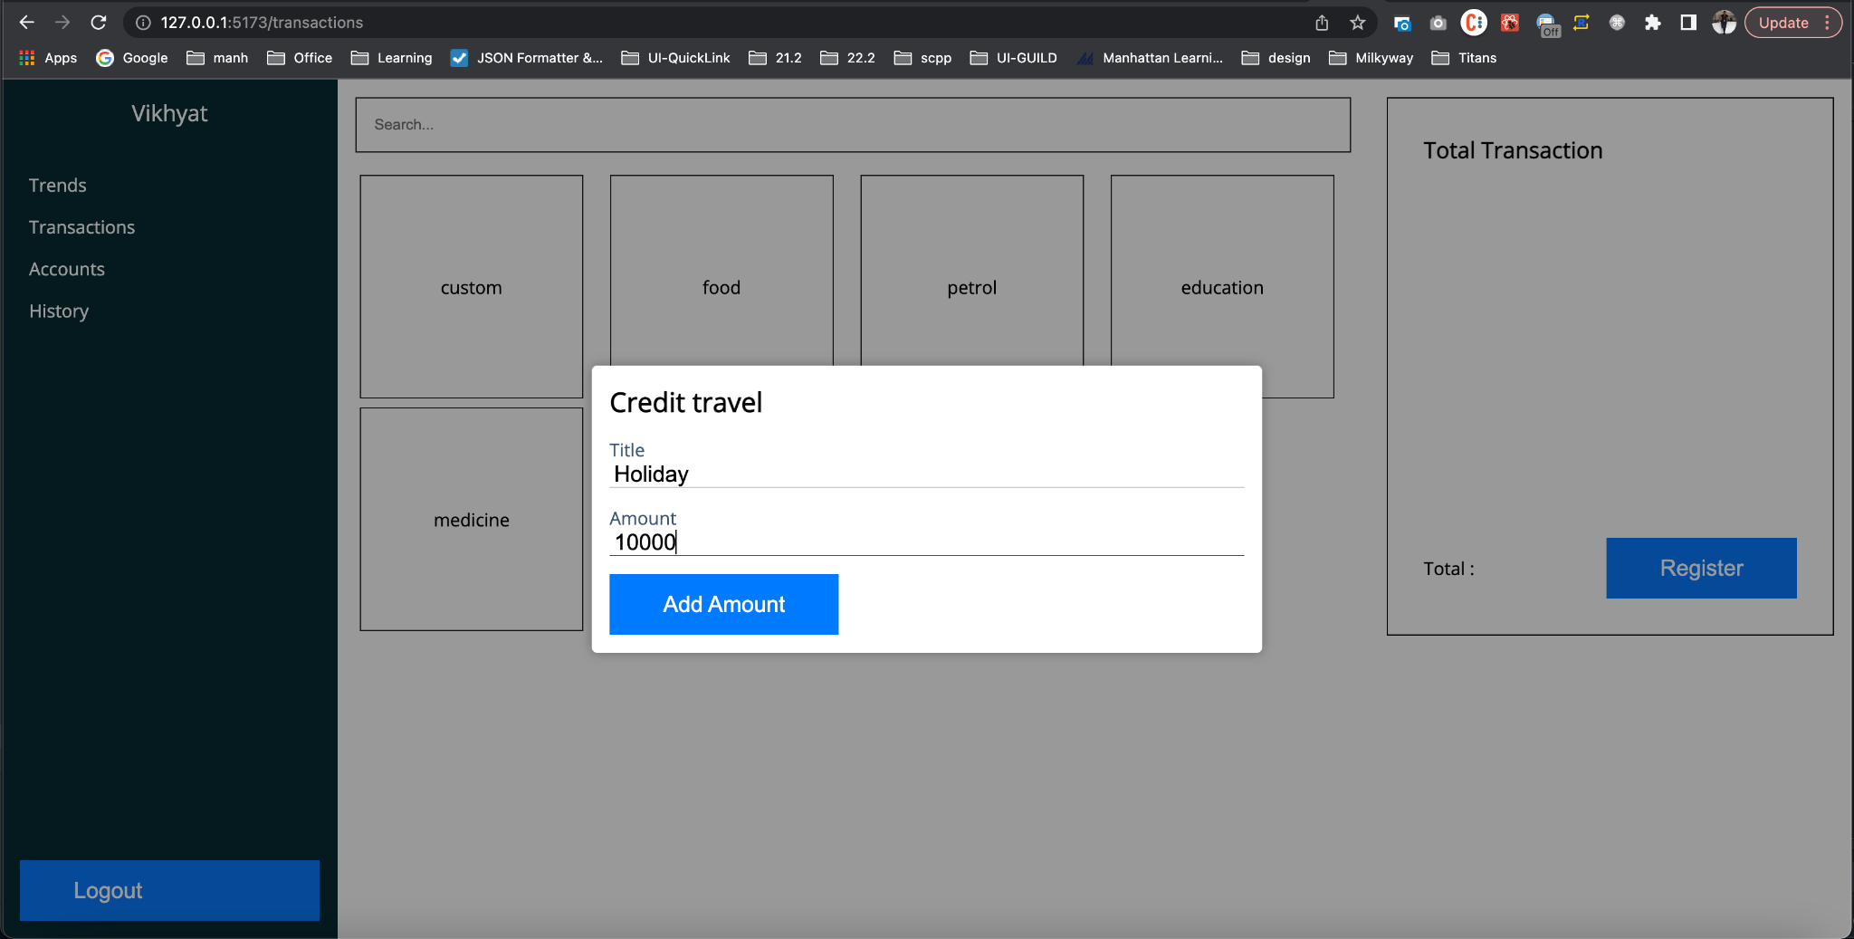
Transactions(s) Purchase

Slide 4
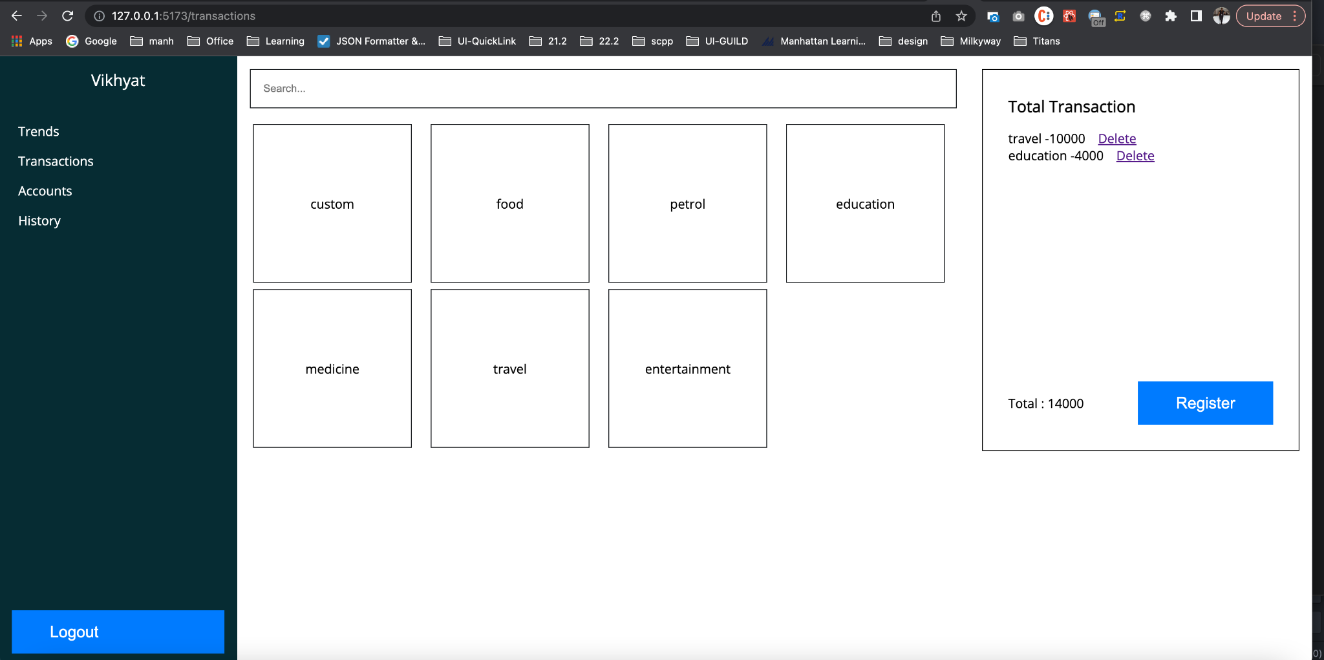
Total Transaction with Delete option

Slide 5
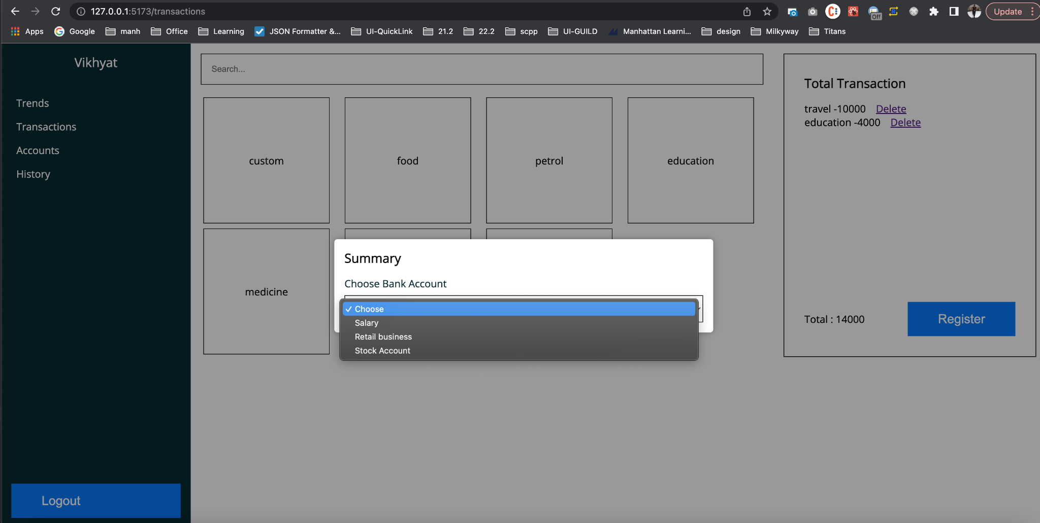
Select Account For Deduction

Slide 6
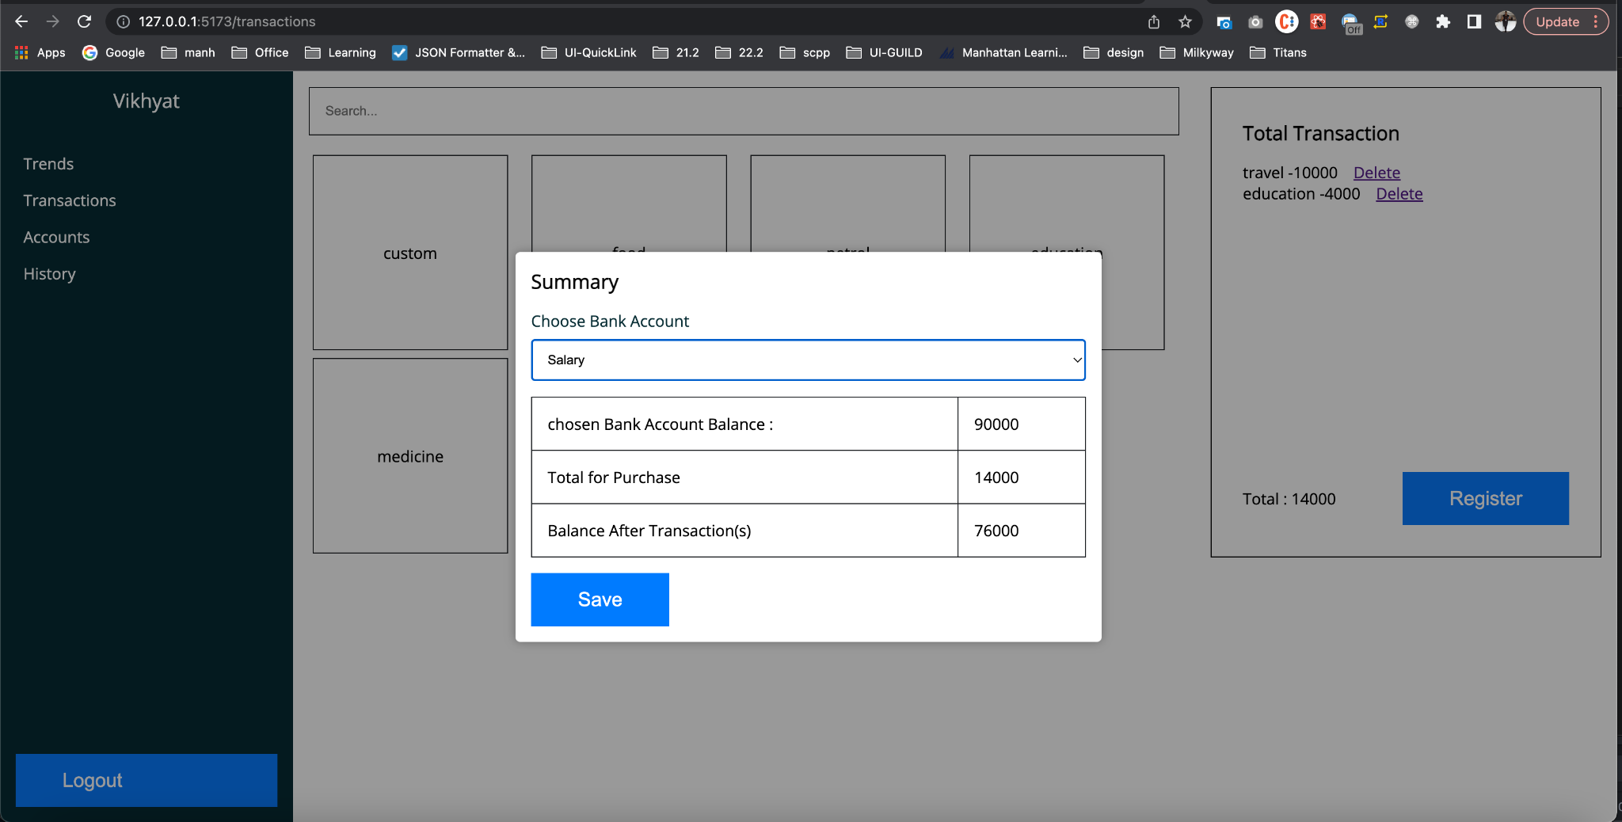
Account Summary after transactions

Slide 7
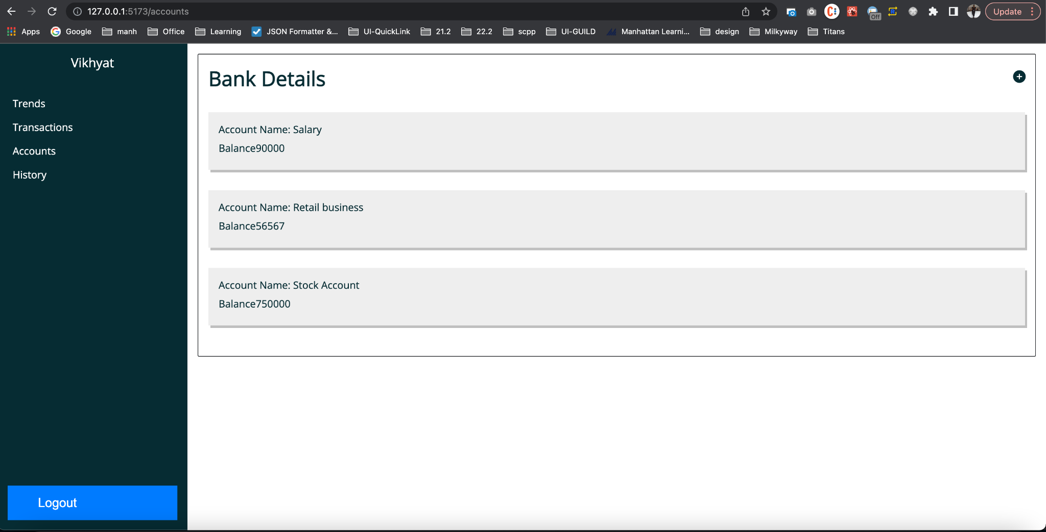
Bank Accounts

Slide 8
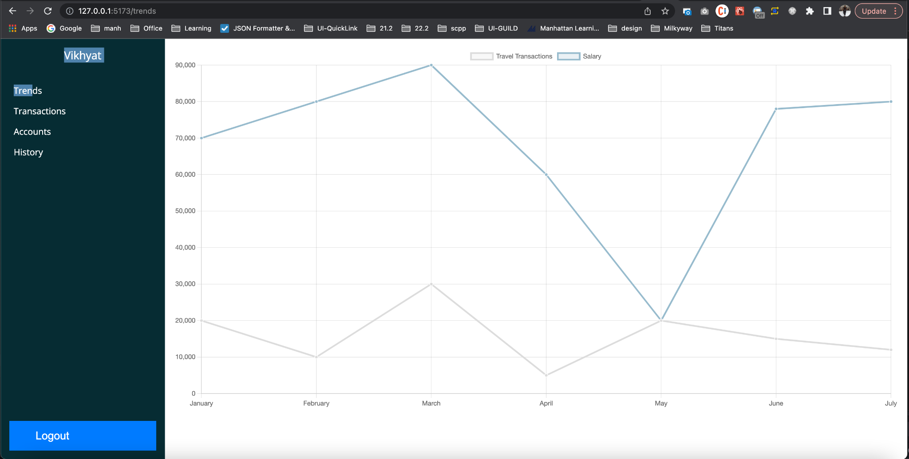
Trends

Slide 9
Thank You

